Slide 1
Christianity
&
The Frank Empire

Slide 2

Christianity Spreads to N. Europe
  At the start of the Middle Ages not to many kingdoms are Christian.
    Only places once apart of Rome; Spain and Italy
It slowly spread throughout Europe due to two groups.
  Missionaries
  Monks

Slide 3
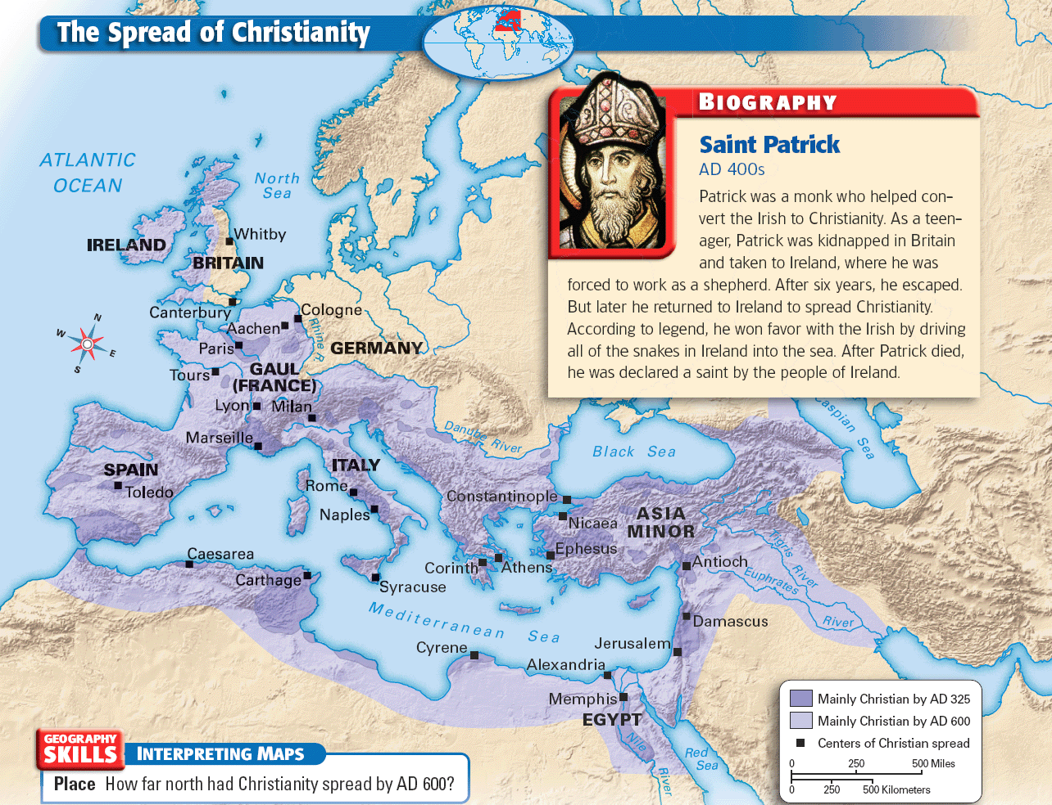

Slide 4
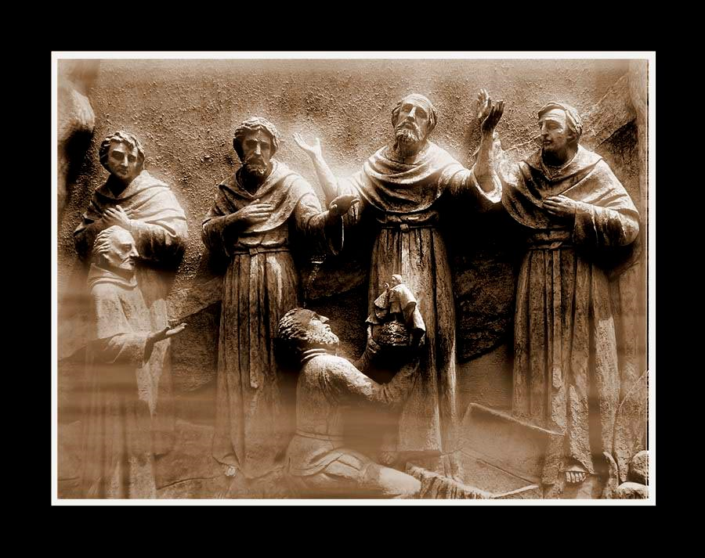
Missionaries
The most powerful force to spread Christianity was the Pope.
He sent out missionaries to teach people about Christianity.
Missionaries are people who try to convert others to a certain religion.
1st place Britain then what is now France & Germany

Slide 5
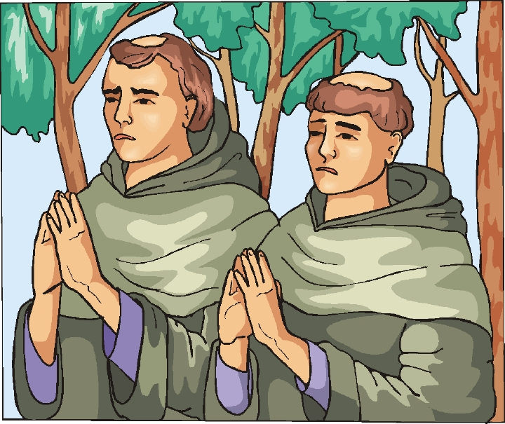
Monks & Monasteries
Religious men known as monks spent their time praying, working, & meditating.
Monasteries were built all over Europe during the Middle Ages, so people could learn about Christianity.

Slide 6
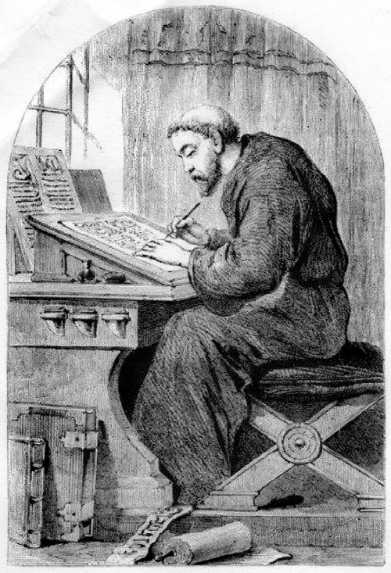
Monks
Besides teaching people about Christianity Monks performed many services.
  Health Care
  Helped the poor
  Ran Schools
  Saved ancient writings
  Copied important books

Slide 7
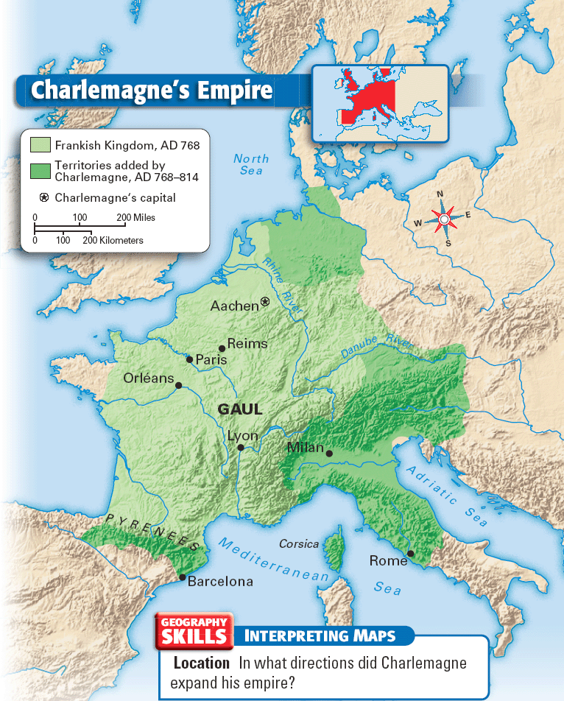
The Franks Build an Empire
As Christianity was spreading North, in the 480s a powerful group called the Franks conquered Gaul (France).
Under their rule, the Franks become Christians & created one of the strongest kingdoms in Europe.

Slide 8
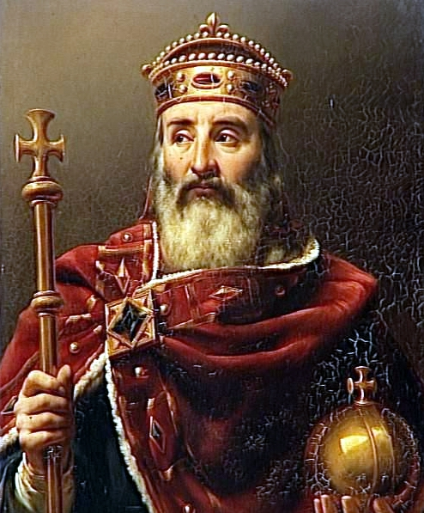
Charlemagne

Slide 9
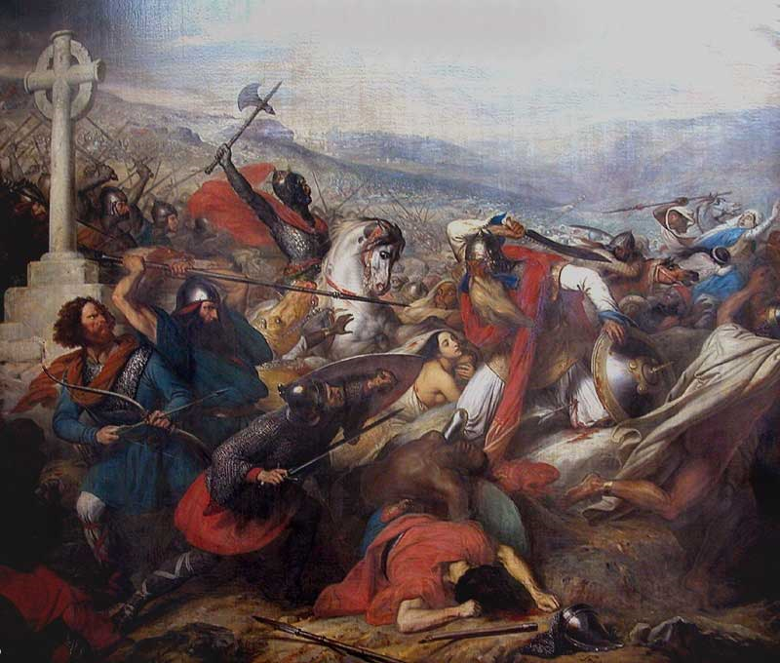
Charlemagne
In 771, Charlemagne became ruler of the Frankish kingdom.
Strong king, & great warrior.
Charlemagne spent most of his time at war conquering neighbors.
In the villages and towns he conquered, he forced people to believe in the Christian God or prepare to meet him
Even conquered parts of the former Roman Empire.
Built a large empire; which included all of France & parts of Italy, Spain, & Germany

Slide 11
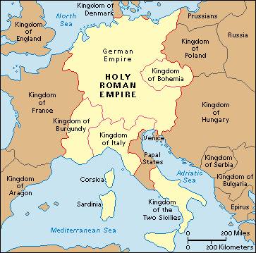
Charlemagne Kingdom
On Christmas 800 A.D., Pope Leo III crowned Charlemagne as Holy Roman Emperor.
This symbolized the return to greatness of the Roman Empire.

Slide 12
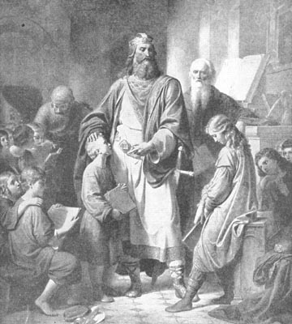
Charlemagne Achievements
Introduced a jury system
Rewrote important manuscripts.
Standardized coin collection for taxes
Built schools for education as well as religion
Helped the Europeans realize they shared a common bond, Christianity.

