Slide 1
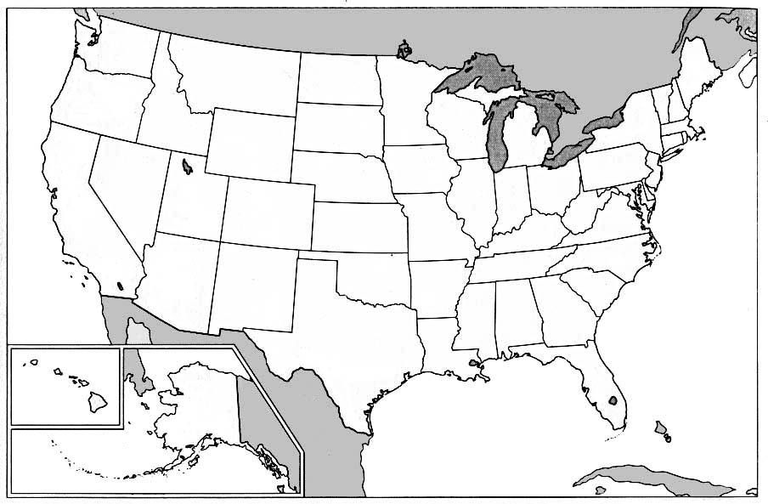
Components of a Map

Slide 2
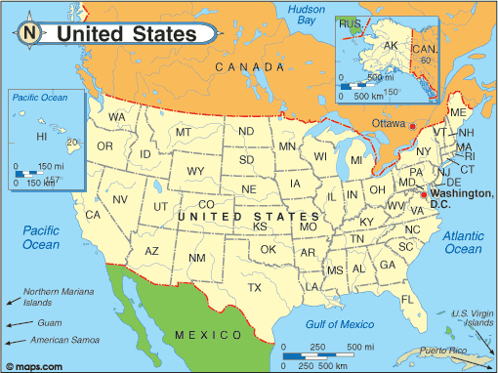

Slide 3
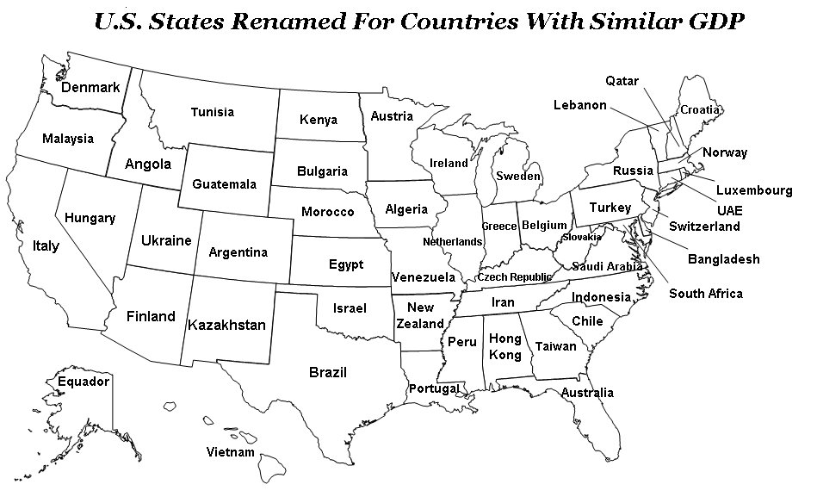
Map Title: labels the name of the map that is displayed often describing what the map is showing

Slide 4
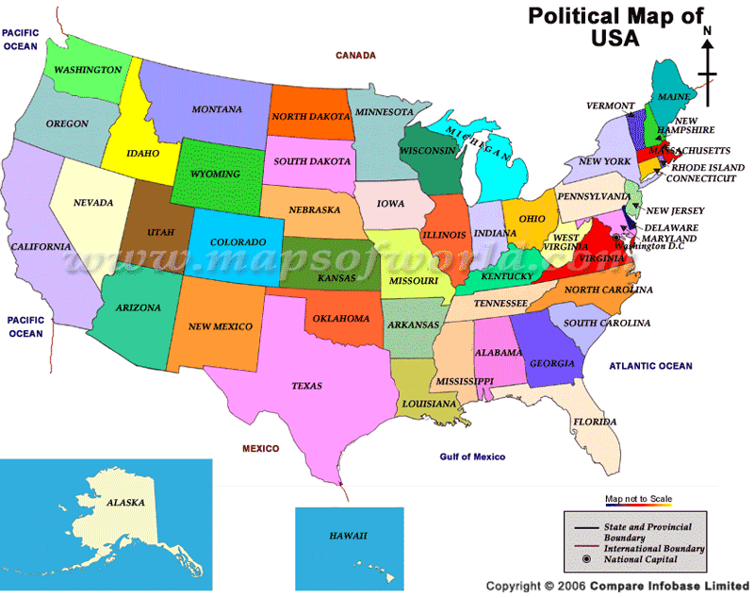
Can you find the map title?

Slide 5
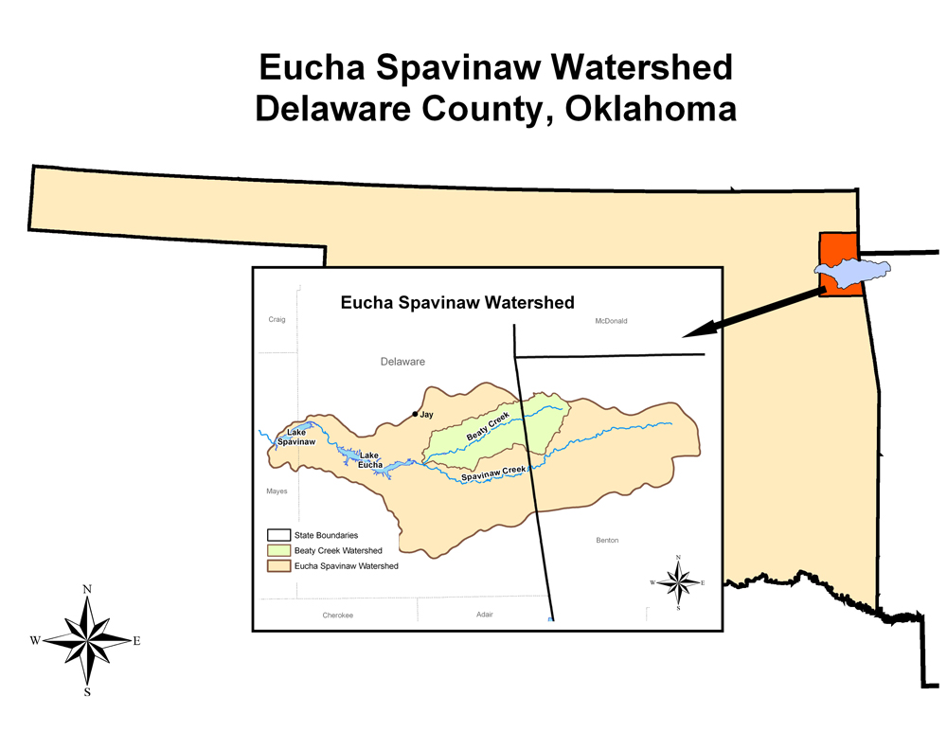
Inset map: Type of map used to show a detailed portion of a larger map.

Slide 6
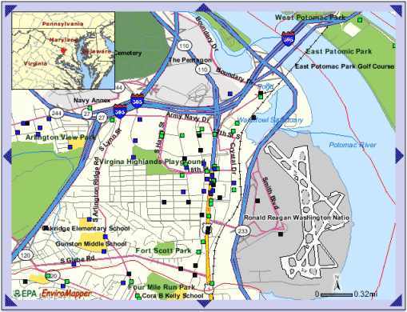
Locator: shows where the subject of the main map can be found in a larger area of the Earth.

Slide 7
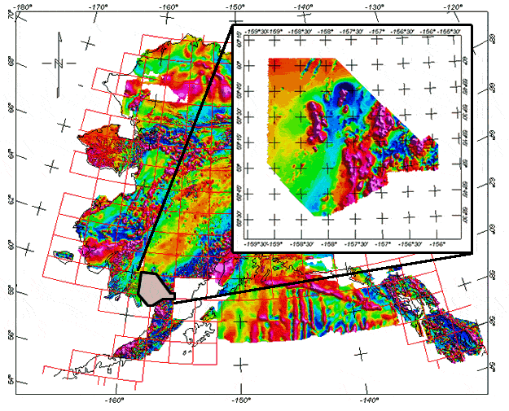
Is this an inset map or locator?

Slide 8
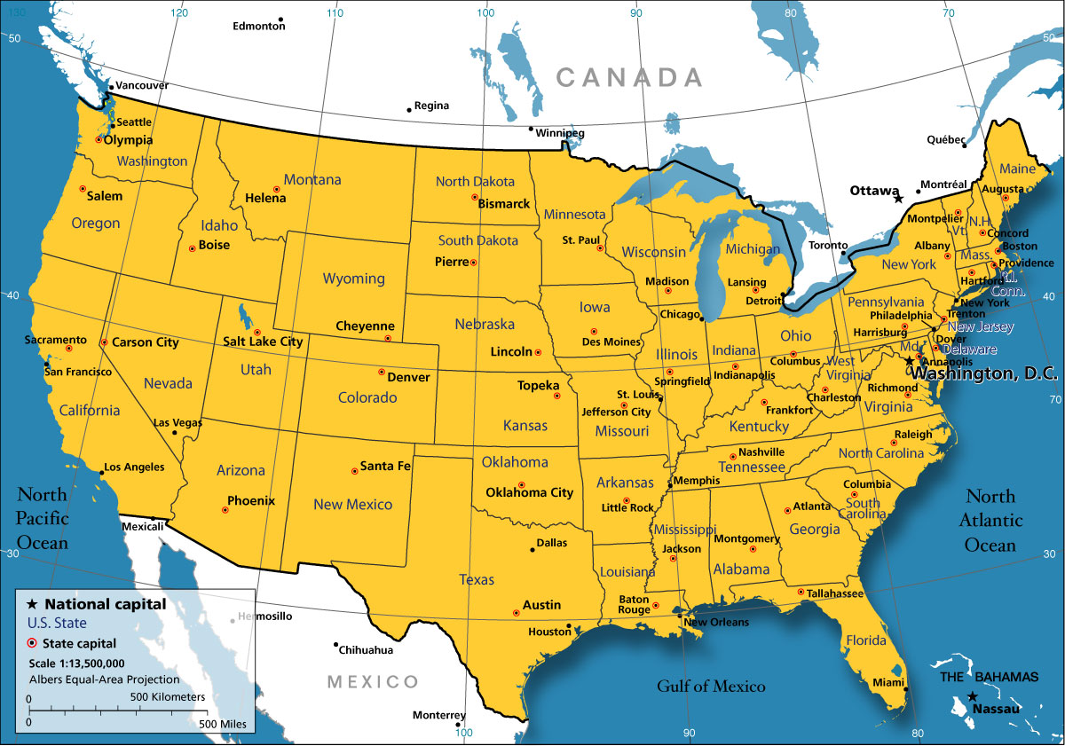
Map key: The box in which a map’s symbols are explained

Slide 9
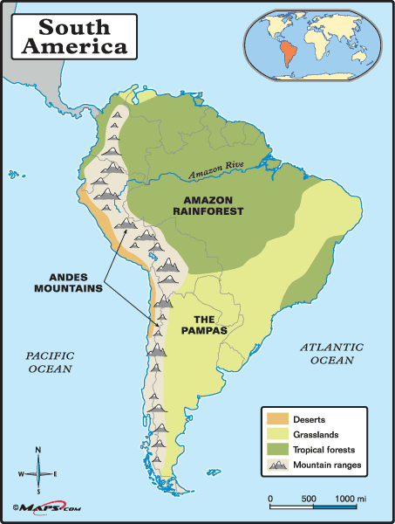
Can you find the map key? What else is on this?

Slide 10
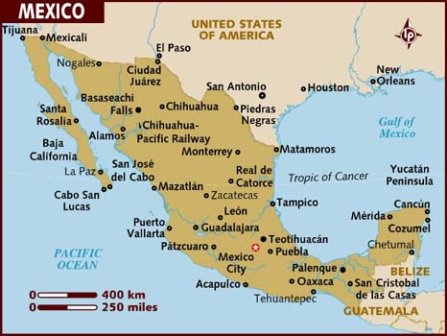
Scale: Helps you estimate real distance on earth.

Slide 11
Can you find the map’s scale?

Slide 12
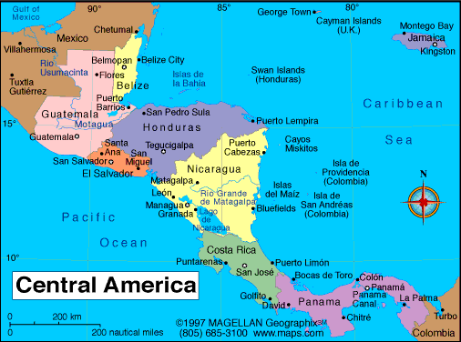
Compass rose: A pointer for cardinal directions; north, south, east, and west.

Slide 13
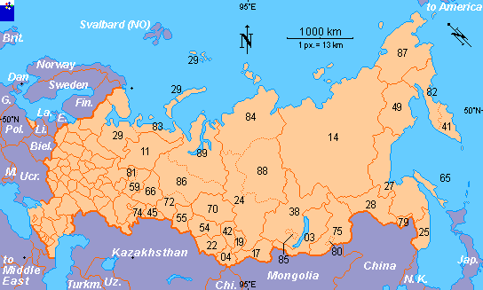
Can you find the compass rose?

Slide 14
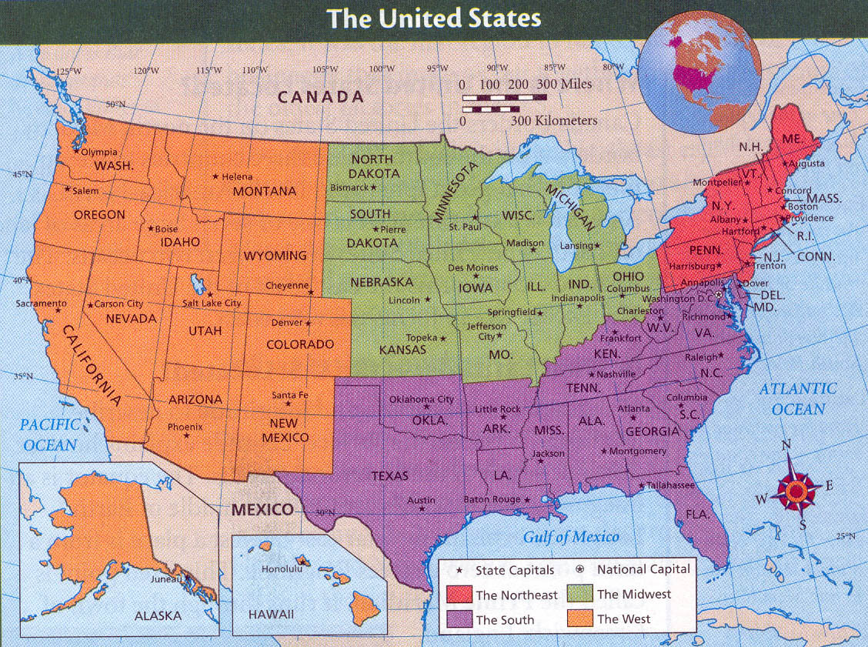
Review

