Slide 1
Geographical Features

Slide 2
Archipelago
A large group or chain of islands.

Slide 3
Atoll
A ring-shaped coral reef or a string of closely spaced small coral islands, enclosing or nearly enclosing a shallow lagoon.

Slide 4
River
A large stream of water that flows across the land.

Slide 5
Source of River
Place where a river or stream begins

Slide 6
Mouth of River
Place where a river empties into another body of water.

Slide 7
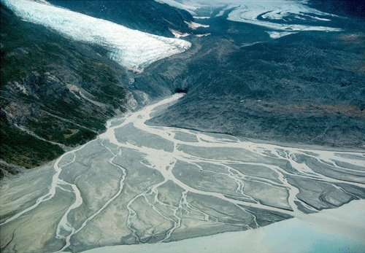
Delta
A triangle-shaped area of land at the mouth of a river.

Slide 8
Tributary
Stream or river that empties into a larger river.

Slide 9
Isthmus
A narrow strip of land connecting two larger areas of land.

Slide 10
Strait
A narrow channel of water connecting two larger bodies of water.

Slide 11
Canal
An artificial/ man made waterway for navigation and irrigation.

Slide 12
Desert
Dry land with few plants.

Slide 13
Oasis
Area of water and fertile land with desert on all sides.

Slide 14
Plain
very large area of flat land, usually good for growing crops

Slide 15
Bay
A body of water that is part of a sea or ocean and is partly enclosed by land.

Slide 16
Gulf
A body of water that is partly enclosed by land but is larger than a bay.

Slide 17
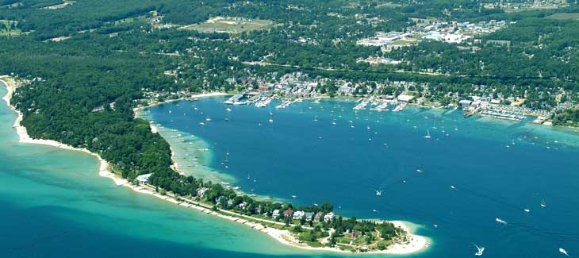
Harbor
Body of water like a bay but with ports and docks
for boats.

Slide 18
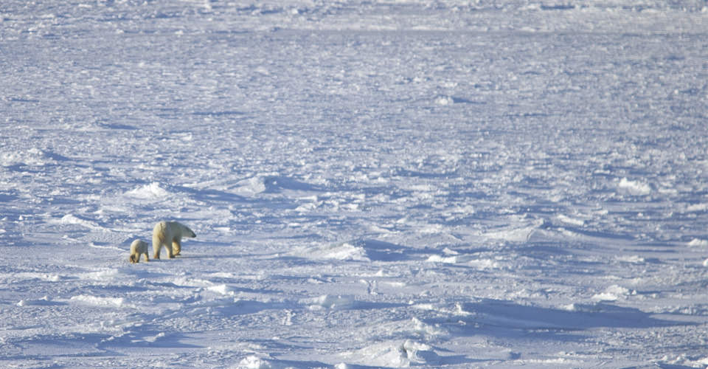
Tundra
Northern part of the Earth where there are no trees and ground is always frozen. (frozen desert)

Slide 19
Glacier
A large ice mass that moves slowly down a mountain or across land.

Slide 20
Mountain Range
A row of Mountains.
A Mountain is the highest kind of land

Slide 21
Plateau
An area of high, flat land with steep sides.

Slide 22
Volcano
An opening in the Earth, often raised, through which lava, rock, ashes, and gases are forced out.

Slide 23
Peninsula
Land that is almost completely surrounded by water.

Slide 24
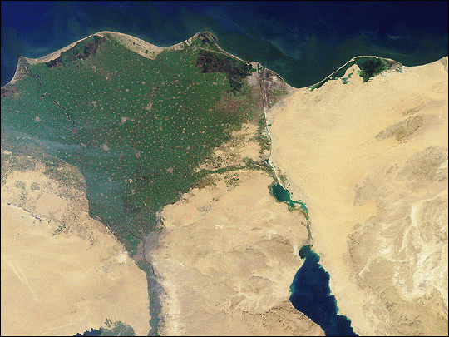
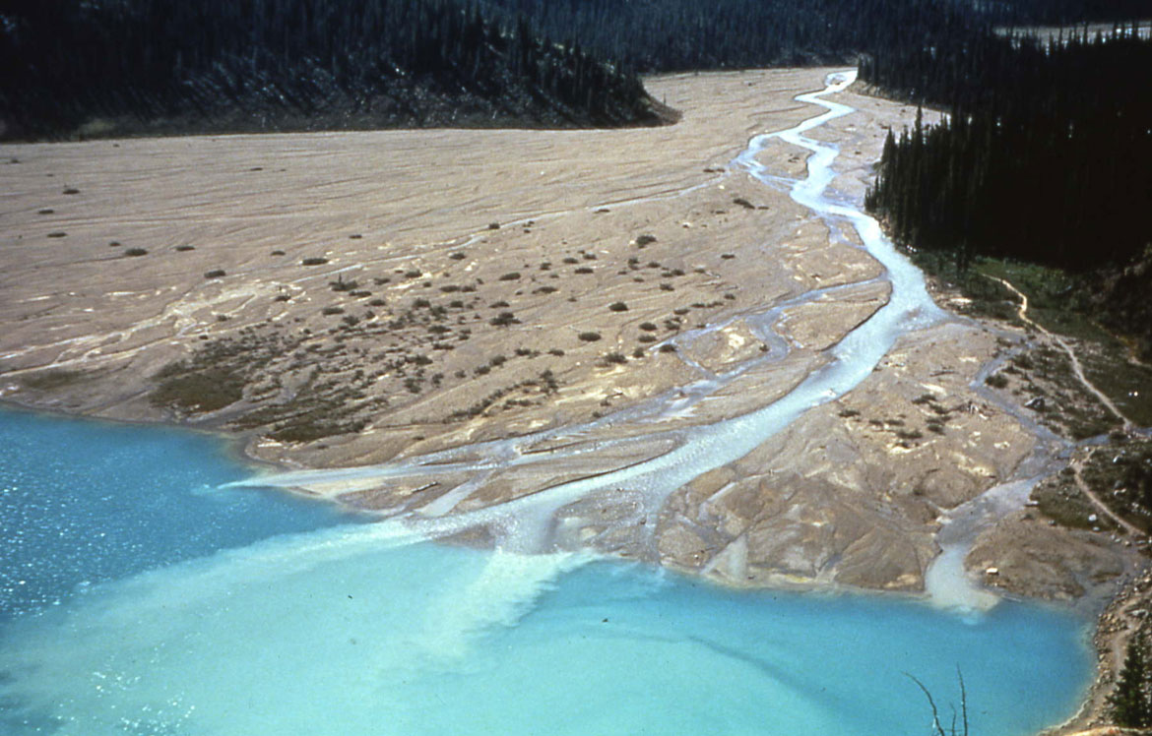
Guess which Feature?
Delta

Slide 25
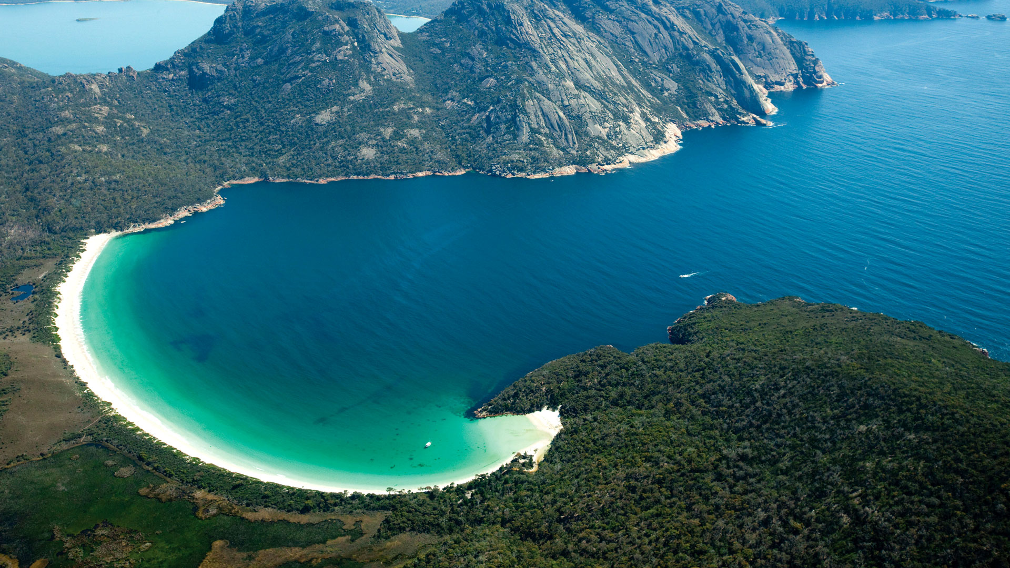
Guess which Feature?
Bay

Slide 26
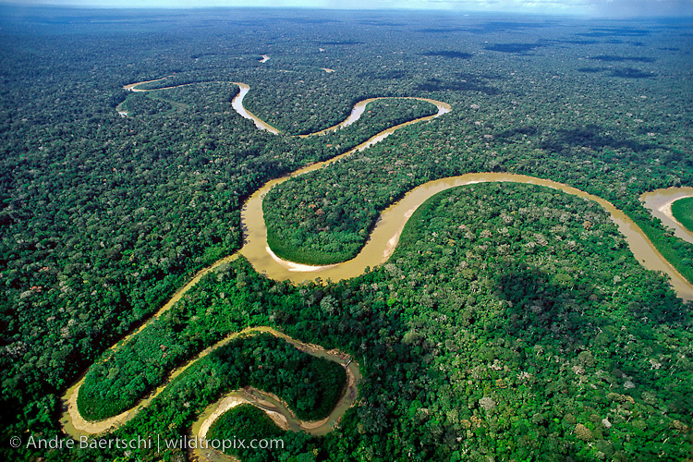
Guess which Feature?
Tributary

