Slide 1
Continents
Cardinal
Directions
Map
components
Latitude and
longitude
Random
10 pt
10 pt
10 pt
10 pt
10 pt
20 pt
20 pt
20 pt
20 pt
20 pt
30 pt
30 pt
30 pt
30 pt
30 pt
40 pt
40 pt
40 pt
40 pt
40 pt
50 pt
50 pt
50 pt
50 pt
50 pt

Slide 2
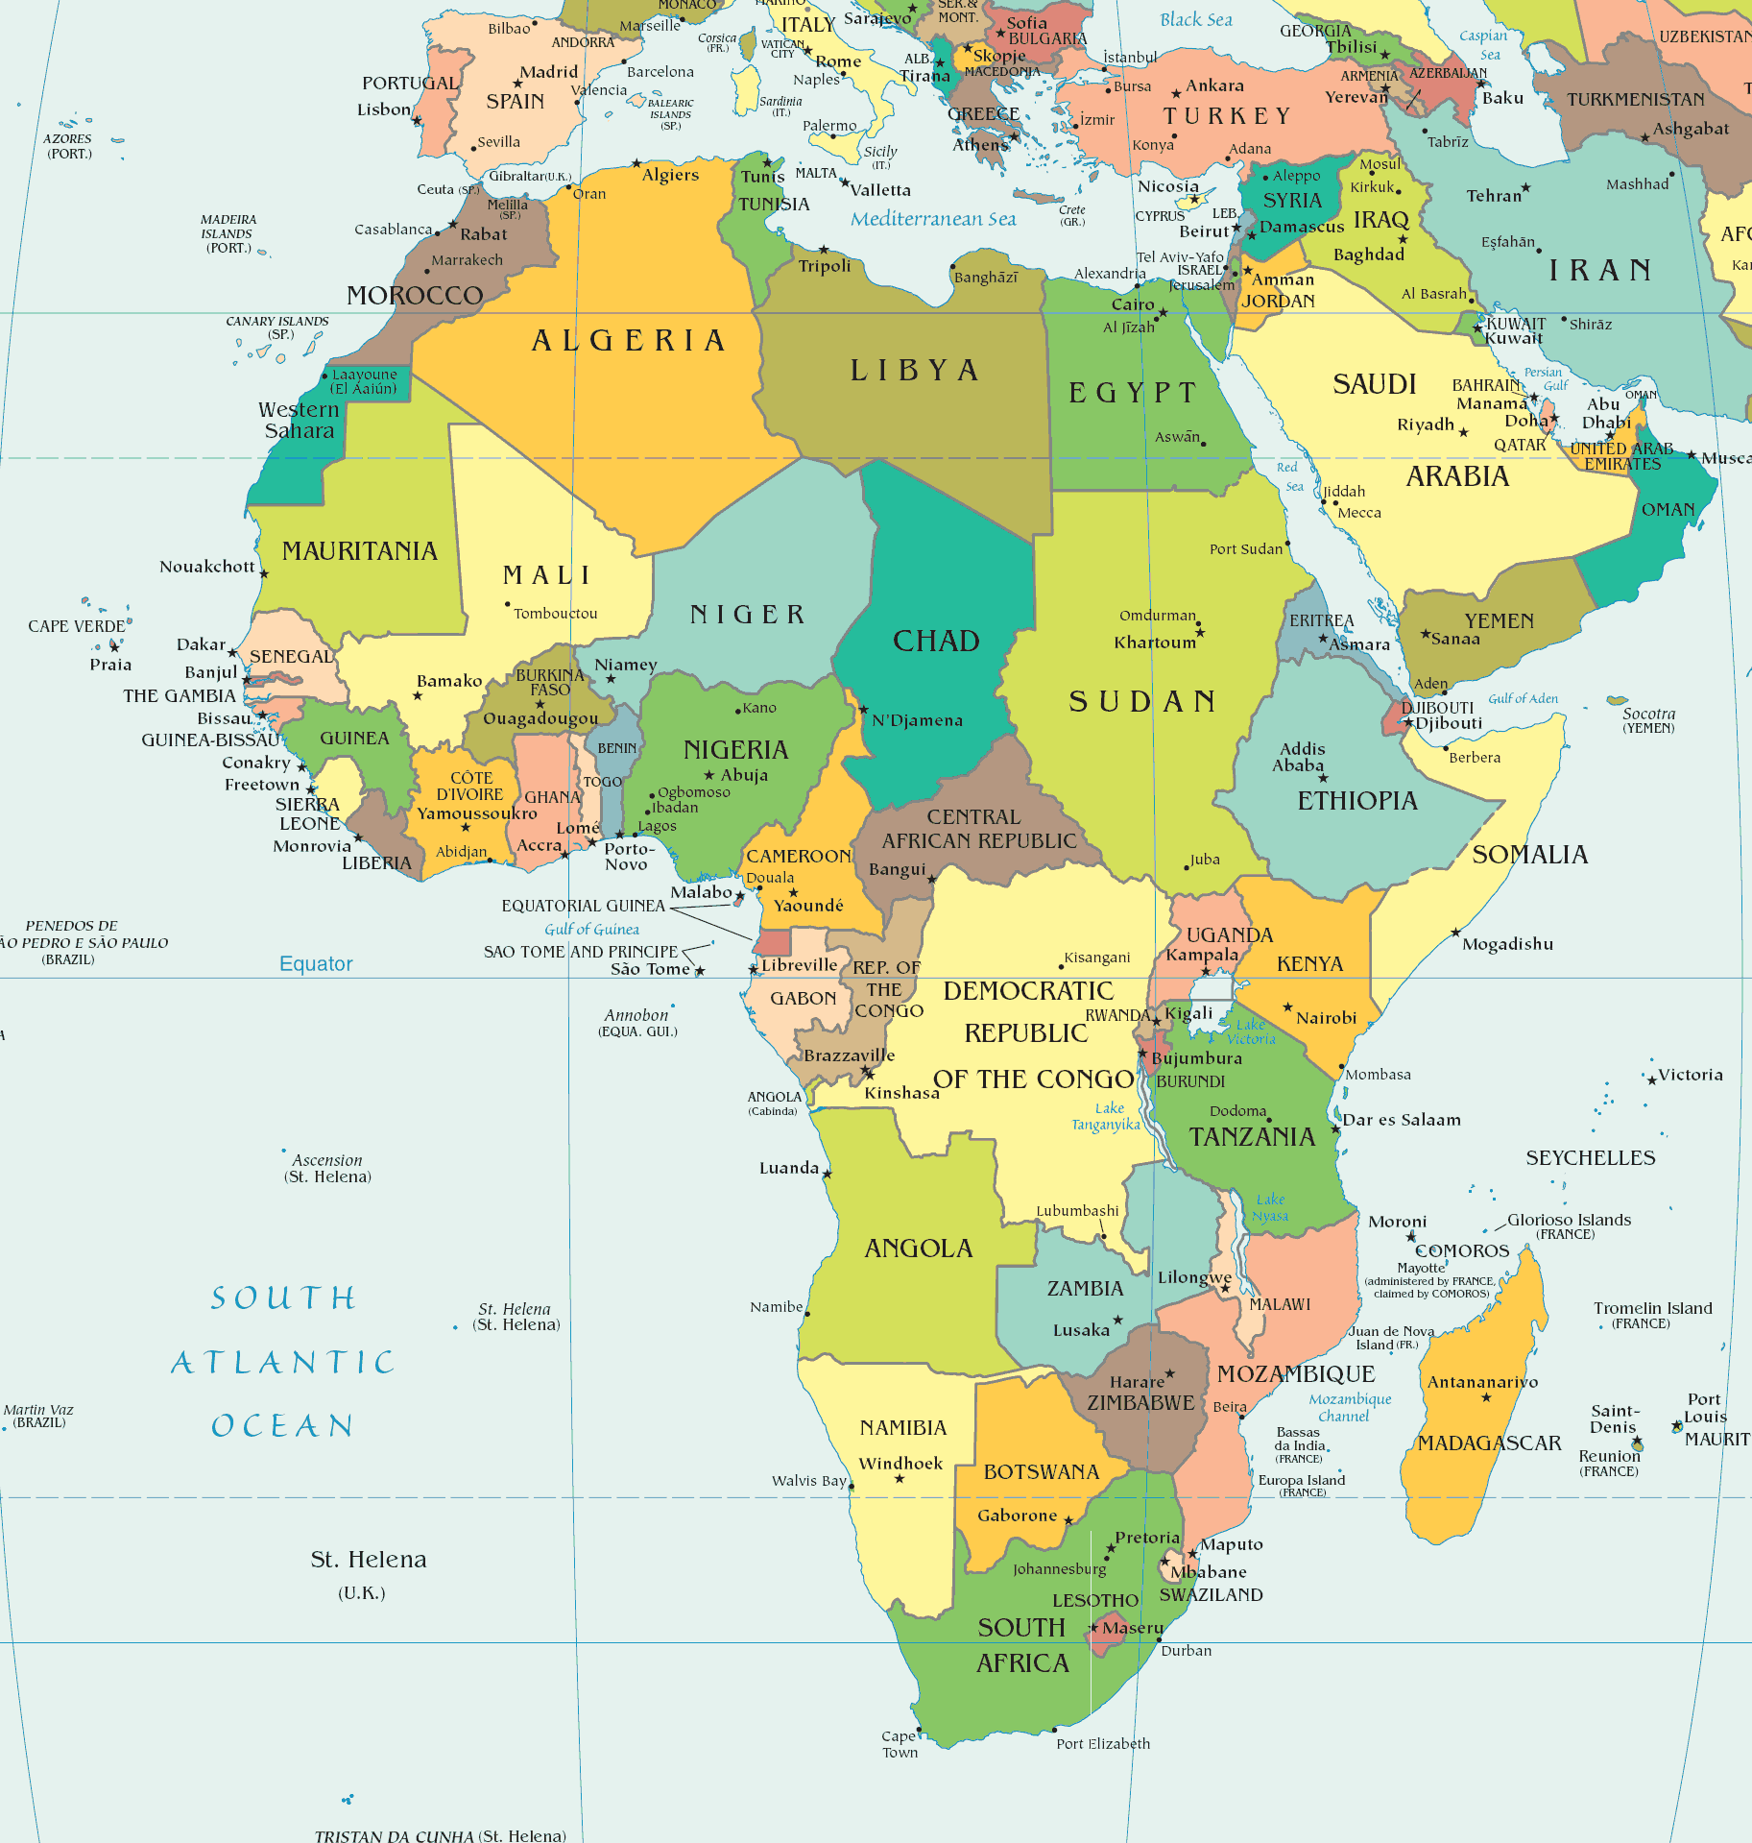
Name this continent

Slide 3
Africa

Slide 4
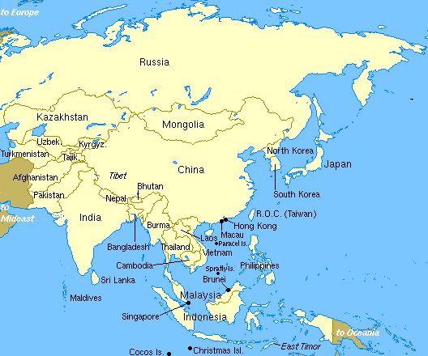
Name this continent

Slide 5
Asia

Slide 6
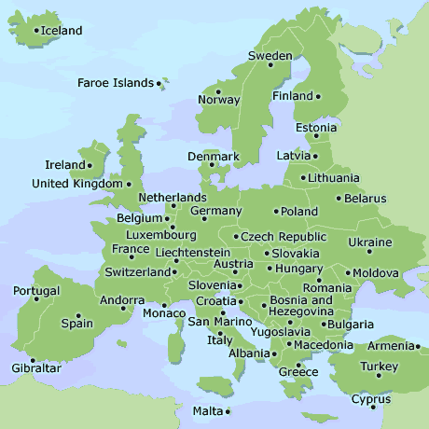
Name this continent

Slide 7
Europe

Slide 8
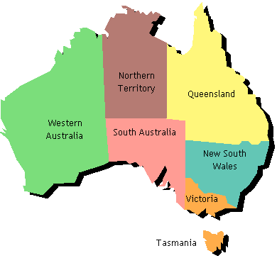
Name this continent

Slide 9
Australia

Slide 10
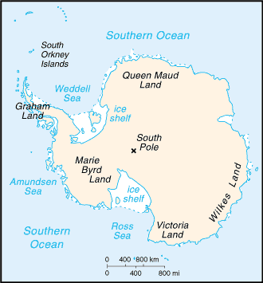
Name this continent

Slide 11
Antarctica

Slide 12
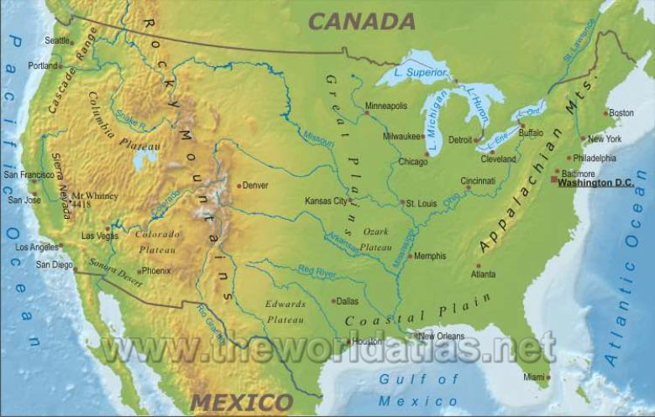
Which direction would you be going if you traveled from the Rocky Mts to the Appalachian Mts?

Slide 13
East

Slide 14
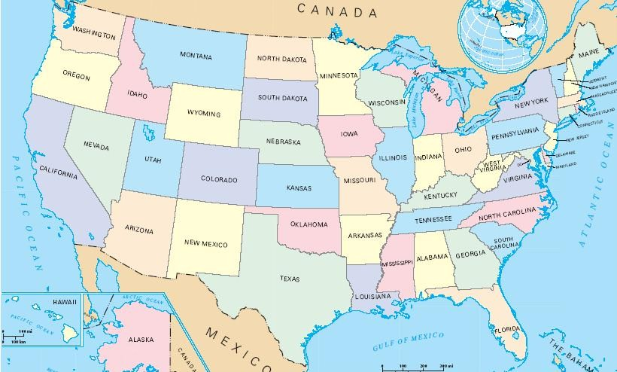
Which direction would you be going if you traveled from Texas to Indiana?

Slide 15
Northeast

Slide 16
Which direction would you be traveling if you went from Michigan to Alabama?

Slide 17
South

Slide 18
Which direction would you be traveling if you went from Montana to Mississippi?

Slide 19
Southeast

Slide 20
Which direction would you be traveling if you went from Florida to Washington?

Slide 21
Northwest

Slide 22
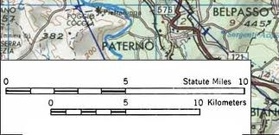
Which map component is this?

Slide 23
Map Scale

Slide 24
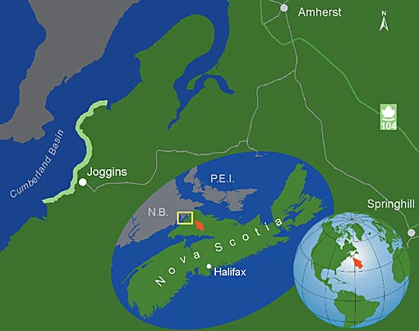
Which map component is this?

Slide 25
Locator

Slide 26
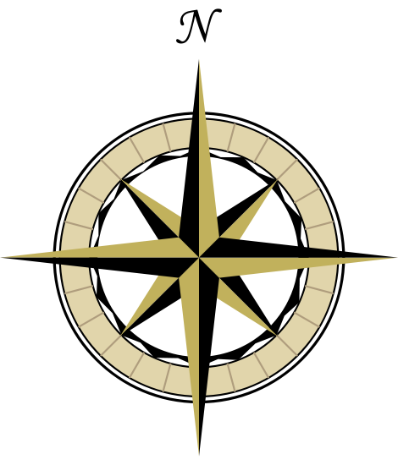
Which map component is this?

Slide 27
Compass rose

Slide 28
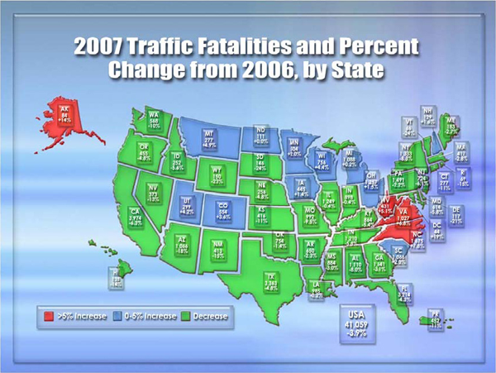
Which map component is this?

Slide 29
Map title

Slide 30
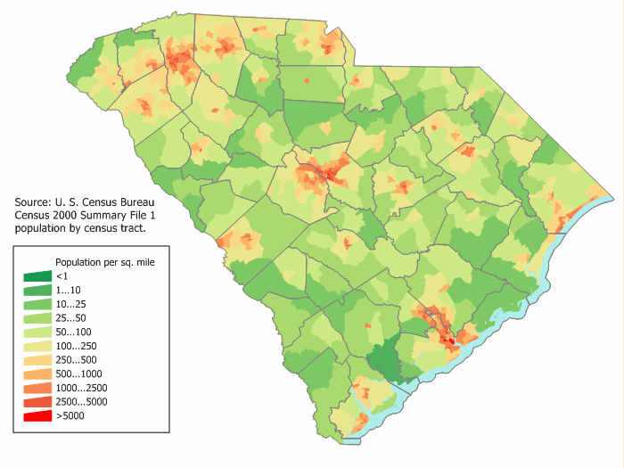
Which map component is this?

Slide 31
Map key

Slide 32
The imaginary lines that run East and West on a globe are called what?

Slide 33
Lines of latitude

Slide 34
The imaginary lines that run North and South on a map are called what?

Slide 35
Lines of longitude

Slide 36
The line of longitude that divides the globe into East and West is called what?

Slide 37
Prime Meridian

Slide 38
The line of latitude that divides the globe into North and South is called what?

Slide 39
Equator

Slide 40
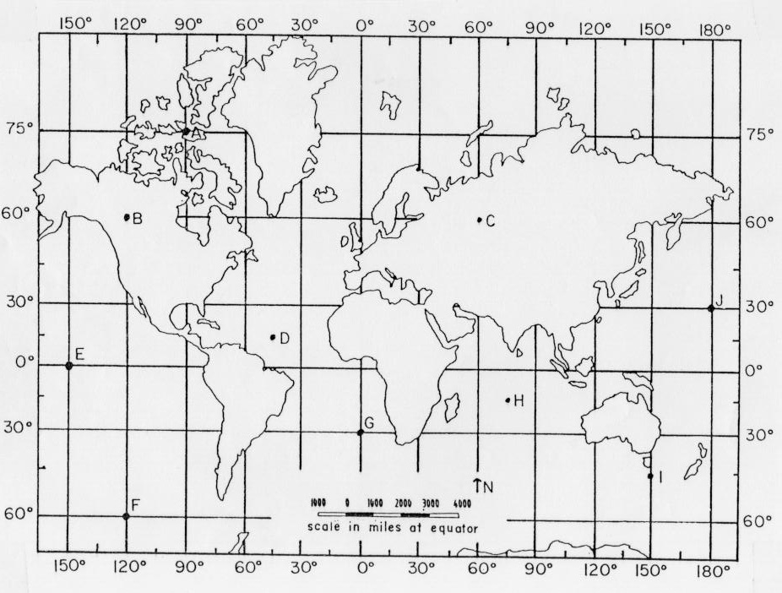
What continent is at 30 degrees South and 60 degrees West?

Slide 41
South America

Slide 42
What type of map shows cities, capitals, and borders?

Slide 43
Political Map

Slide 44
What type of map shows the landforms of an area?

Slide 45
Physical map

Slide 46
Which year is older? (Which year is further away from today?)
210 BC or 209 BC?

Slide 47
210 BC

Slide 48
What landform has an area of high, flat land with steep sides?

Slide 49
Plateau

Slide 50
What is the difference between a source and mouth of a river?

Slide 51
The source is where the river begins, and the mouth is where it ends.

