Slide 1
Working with Maps
Understanding the Hemispheres
Understanding the Compass Rose
Using Longitude and Latitude

Slide 2
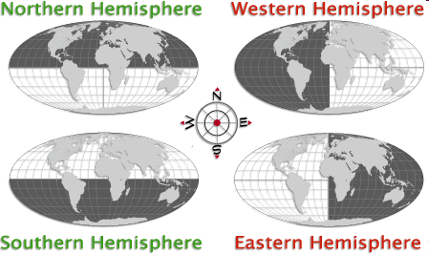
The World Hemispheres

Slide 3
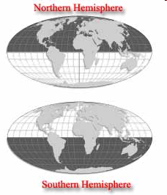
Northern and Southern Hemisphere
It’s often easier to study something large if we divide it into smaller parts.
Imagine a line that circles the planet Earth halfway between the North and South poles, this is called the EQUATOR

Slide 4
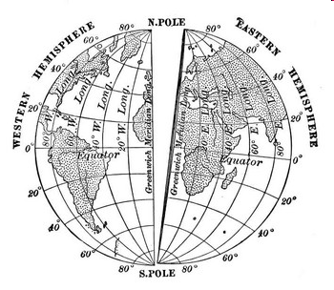
Eastern and Western Hemisphere
The PRIME MERIDIAN divides the world into Eastern and Western Hemispheres.
Like the equator its an imaginary line that goes from pole to pole.
It passes through Greenwich, England

Slide 5
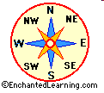
The Compass Rose
There are 4 cardinal directions.
- North
- East
- South
West
A mnemonic device to remember this is Never Eat Sour Wheat

Slide 6
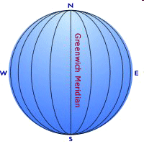
Lines of Longitude
Lines that run North & South are called Longitude Lines
They measure the distance east and west of the Prime Meridian

Slide 7
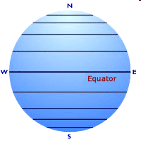
Latitude Lines
Lines that run East & West are called Latitude Lines
They measure the distance North and South of the Equator.
A way to remember which way the Latitude Lines run is “Lat is Flat”

Slide 8
Longitude & Latitude
Pilots and ship captains must be able to report exactly where they are at all times. The lines you see on some globes and maps help them do that.
Longitude and Latitude are measured in degrees. The symbol for degrees is a small raised circle.

