Slide 1
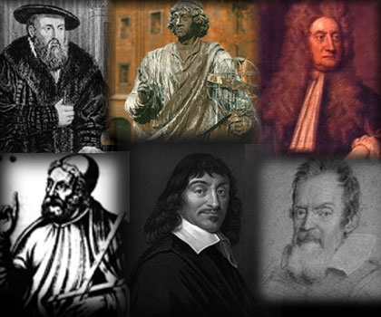
The Scientific Revolution

Slide 2
Building Background
Using the Roman and Greek scientific texts that were rediscovered in 1300’s, scholars began to make their own advancements.
By the 1500’s the Renaissance was well underway. Educated people began to focus more on the world around them. Due to great advancements in art, writing, and education; the stage was set for anther revolution in thinking.

Slide 3
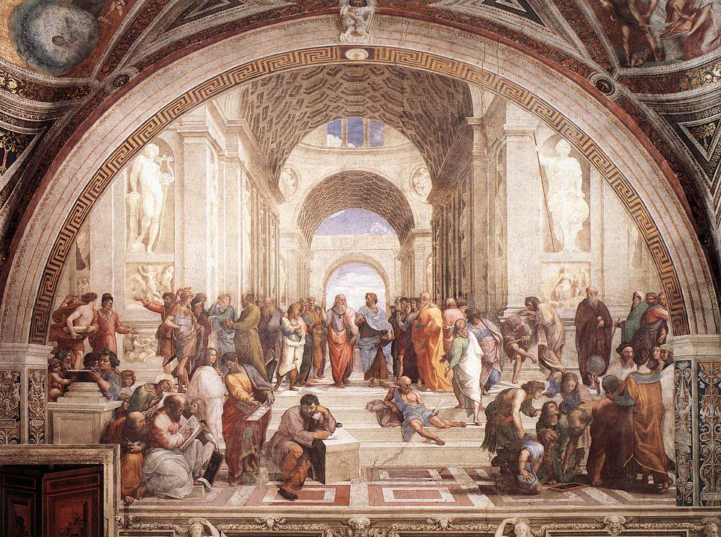
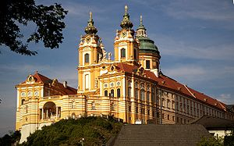
The Birth of Modern Science
Occurred in Europe between 1540-1700
Prior to this most educated people just accepted the teachings of authorities from Ancient Greek writers or Catholic Church officials
The Scientific Revolution allowed people to feel freer to question old beliefs.
They did this by using logic

Slide 4
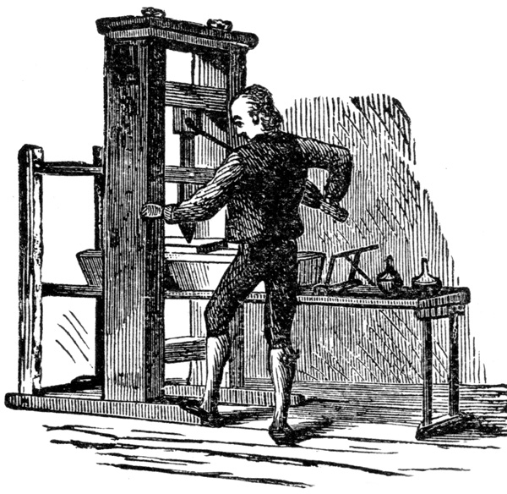
Ideas Spreading In Europe
Travelers and artists help spread the Renaissance idea in Europe.
The largest factor was the invention of the printing press by Johann Gutenberg.

Slide 5
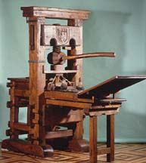
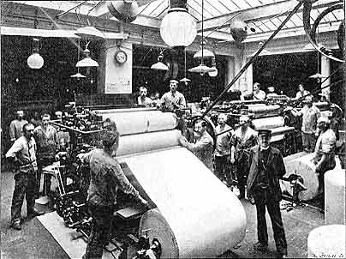
The Printing Press
1436’s the press was invented
The printing press made books more available and cheaper.
This is the idea of Supply and Demand
Before the printing press people had to copy books by hand
The bible becomes more available, more people learn to read and want an education

Slide 6
Roots of the Revolution
Greek thinkers Aritotle and Ptolemy wrote about astronomy, geography, and logic
Muslim scholars translated these works and added their own ideas
The Europeans learned from these writings.
Developments in Europe also help bring about the revolution.
1. Growth of Humanism (encouraged study of natural world)
2. Popularity of Alchemy (metals to gold)

Slide 7
What is Science? You Tell Me….

Slide 8
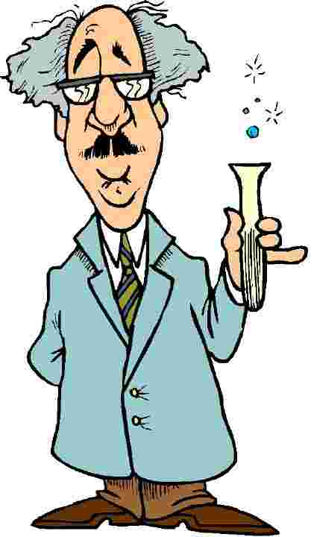
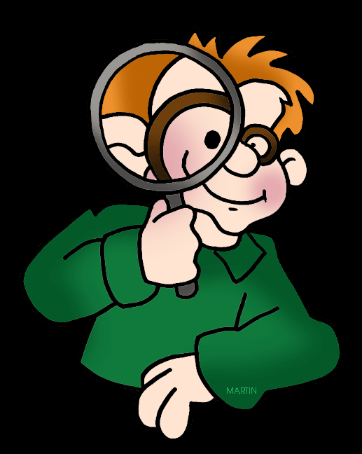
Science
Science is = A way of gaining knowledge about the world.
Latin meaning = “Knowledge” or “Understanding”

Slide 9
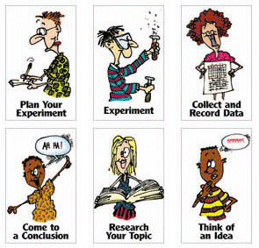
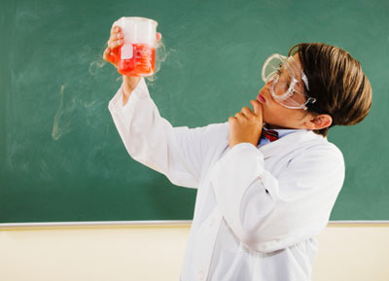
Scientific Method
Science starts with observation = Identifying Facts
Then they use logic to explain what they have
The explanations scientists develop to explain observed facts are called theories
Scientists then designed experiments to test the theories
Before the Scientific Revolution this method of gaining knowledge was uncommon

Slide 10
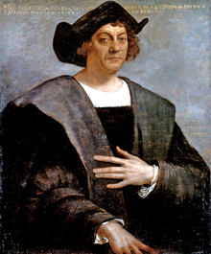
Change of Thought
Before European scholars trusted the teachings of Greek thinkers but then something happened.
1492 Christopher Columbus sails the Atlantic trying to get to Asia using Ptolemy’s map
Instead he gets to North America something no one knew about.
Soon scholars began questioning the accuracy of other authorities.

Slide 11
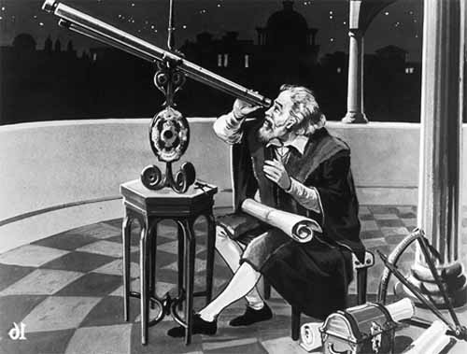
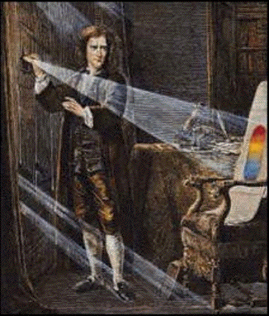
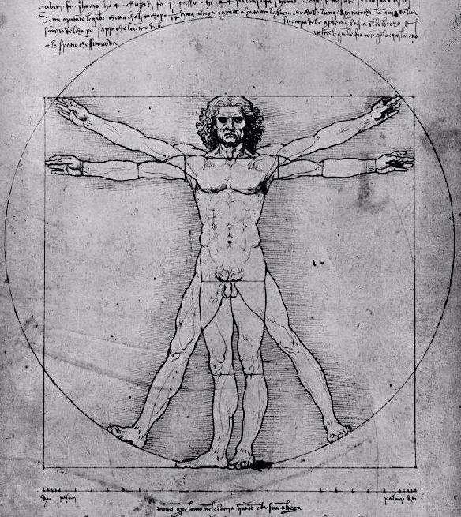
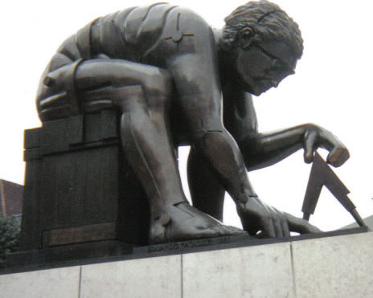
Effects on Society
The Scientific Revolution changed the way we learn about the world.
Some thinkers began to believe certain laws govern human nature. So if we all have the same laws, we all must be equal
Also created conflict with church teachings.
Church officials feared science will lead people to question their faith.

Slide 12
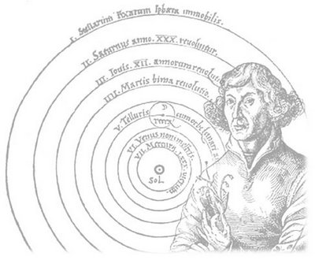
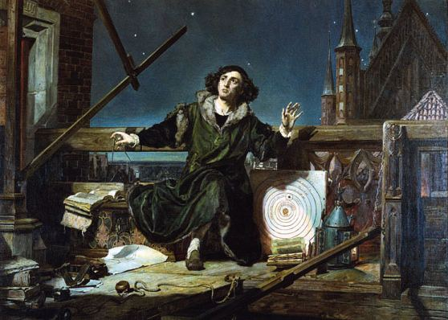
Nicolaus Copernicus
In 1543 the book “On the Revolution of the Celestial Spheres” was written.
A lot of people believe this marked the beginning of the Scientific Revolution.
1,400 yrs before Ptolemy said sun & planets orbit around the earth. He said this does not make sense.
He believed they all revolved the sun in a circular orbit. Never able to prove this though

Slide 13
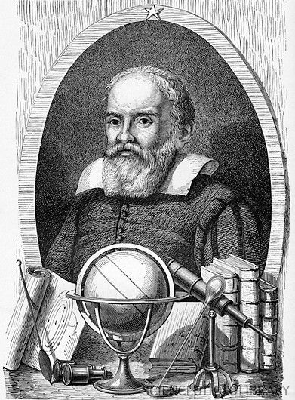
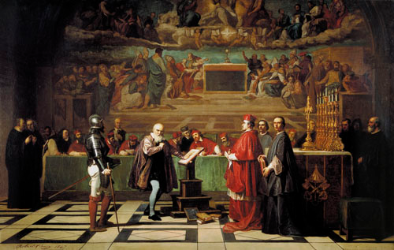
Galileo Galilei
1st to study the sky with a telescope.
Saw craters & Mt. on the moon
Found moons orbiting Jupiter
Biggest contribution was the way he studied the world. He set up experiments.
1st scientist to routinely use experiments to test theories.

Slide 14
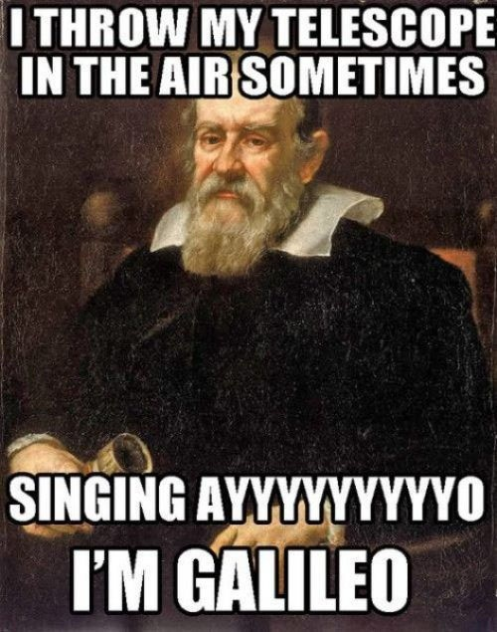

Slide 15
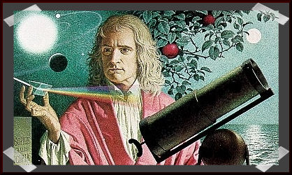
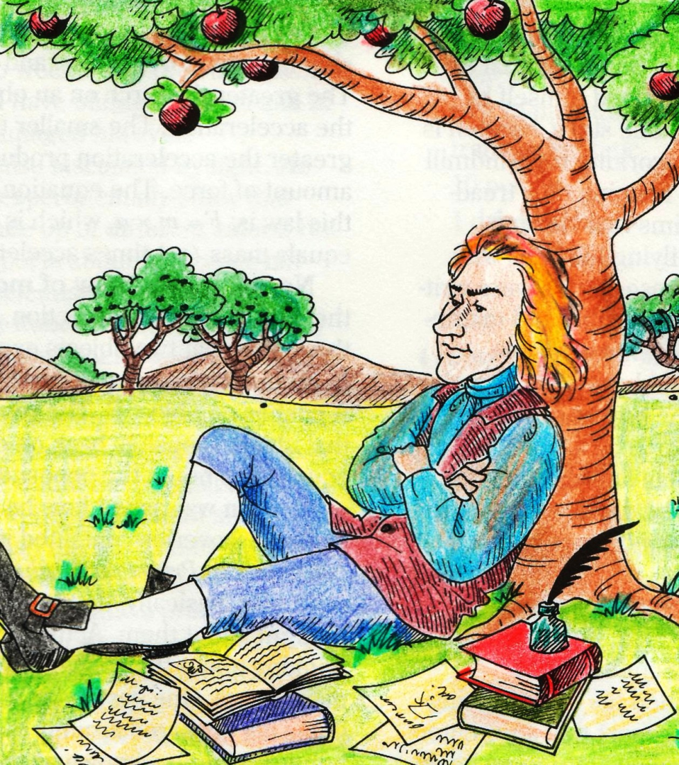
Sir Isaac Newton
His research marks the high point of the Scientific Revolution
Developed the law of gravity = force that attracts objects to each other.
Why an apple falls
Planets orbit around sun
Made 3 other laws called the law of motion = Describes how objects move in space.

