Slide 1
Types of Maps

Slide 2
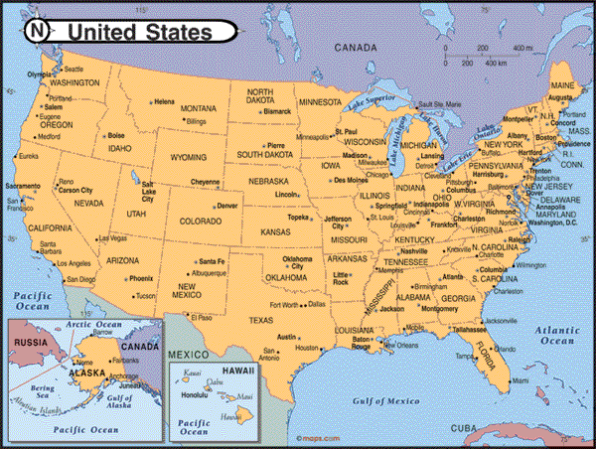
Political Maps
Political maps show how people have divided places on the Earth into countries, states, cities and other units for the purpose of governing them.

Slide 3
Political Map

Slide 4
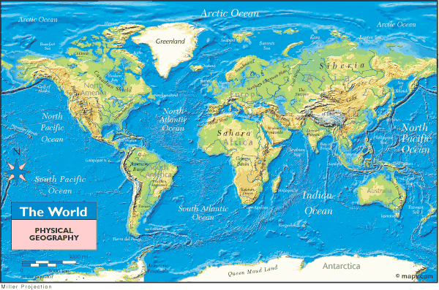
Physical Maps
Physical maps show what the surface of the Earth looks like.
For example, elevation

Slide 5
Physical Map

Slide 6
Population Maps
Population maps show the number of people living in a certain area of land.

Slide 7
Population Map

Slide 8
Topographical Map
Topography is the natural shape of the land.
A topographic map is a detailed and accurate illustration of cultural and natural features on the ground.

Slide 9
Topographical Map

Slide 10
Natural Resource Maps
Natural resource maps provide detailed information about the natural resources available on Earth.

Slide 11
Natural Resource Map

Slide 12
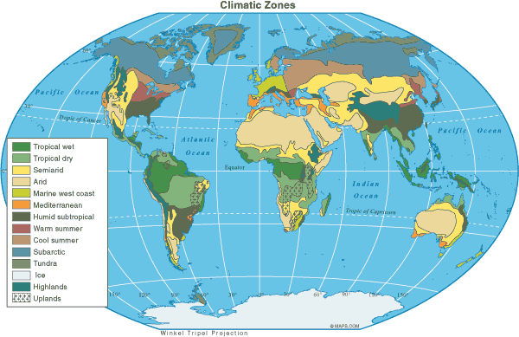
Global Climates
Students generally associate Arctic and Antarctic with cold weather, so students could make the observation that the climate at the poles is cold. This map shows the general climate regions of the world.

Slide 13
Map Review
1. What is the purpose of a Political map?
To show man-made borders of countries, states, and cities.

Slide 14
Map Review
2. What is the purpose of a Physical map?
Physical maps show what the surface of the world looks like, such as elevation and rivers.

Slide 15
3. What kind of map is this?
Resource Map

Slide 16
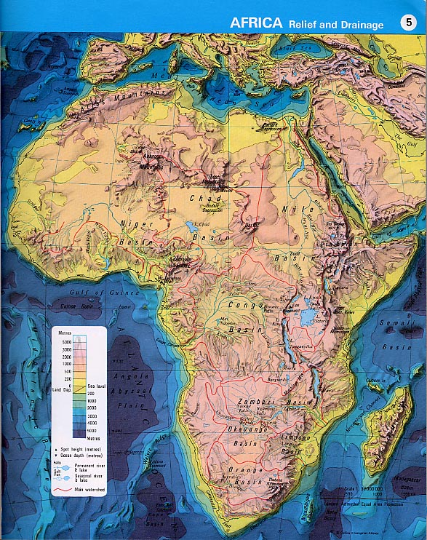
4. What kind of map is this?
Physical
Map

Slide 17
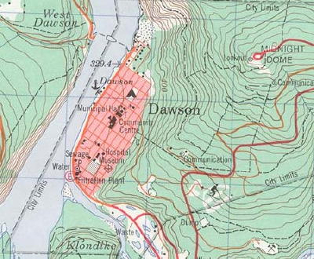
5. What kind of map is this?
Topographical Map

Slide 18
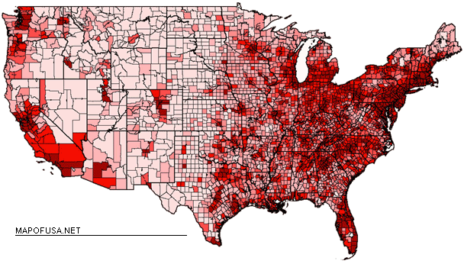
6. What kind of map is this?
Population Map

Slide 19
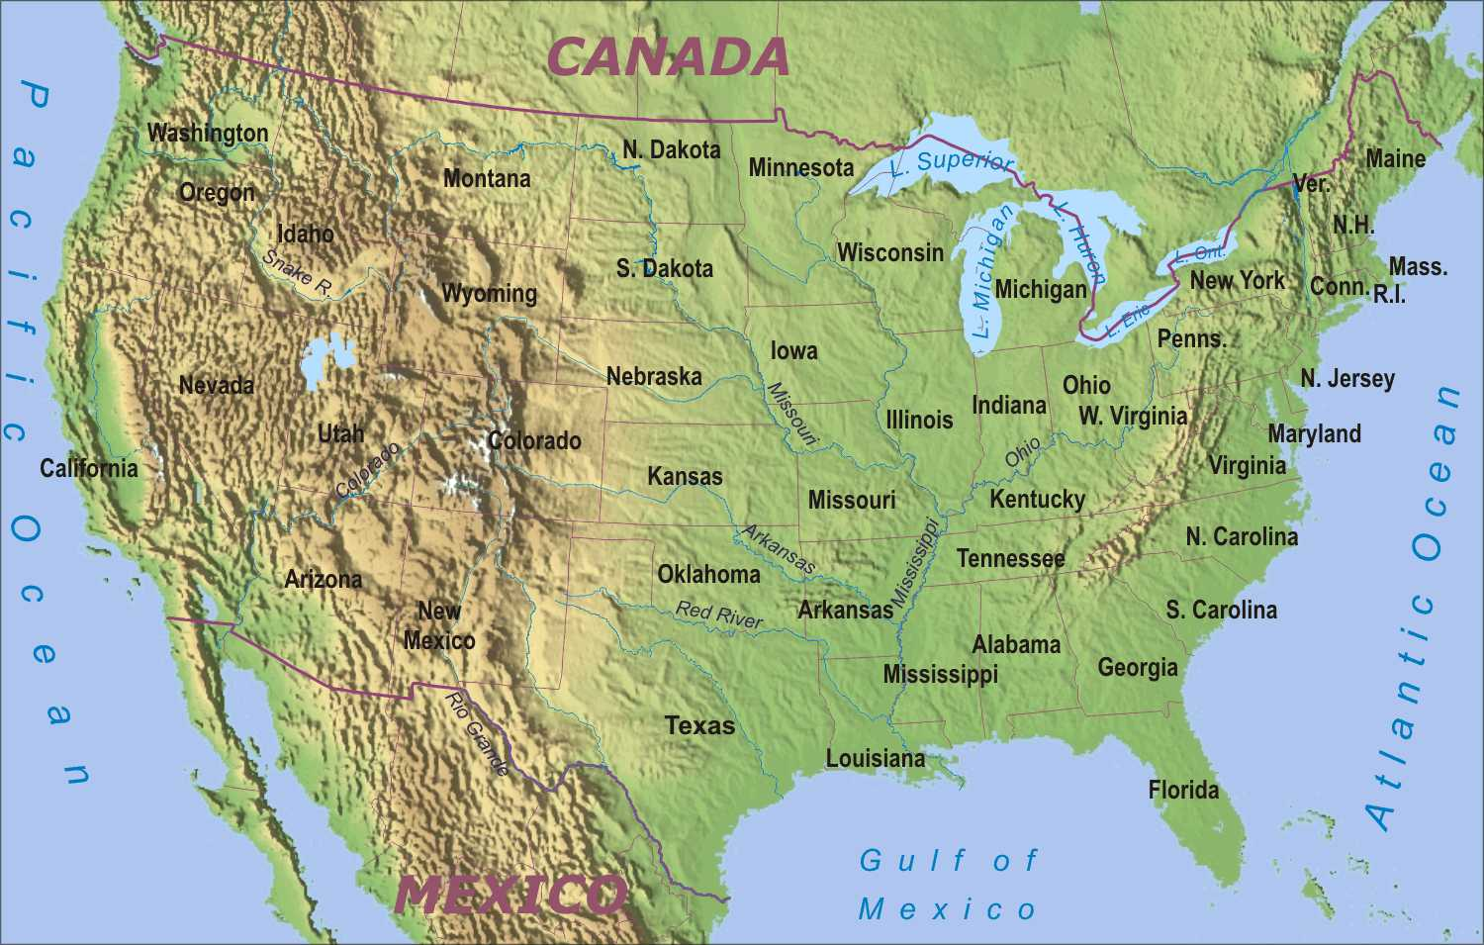
7. What 2 kinds of maps are shown here?
Political
Physical

