Slide 1
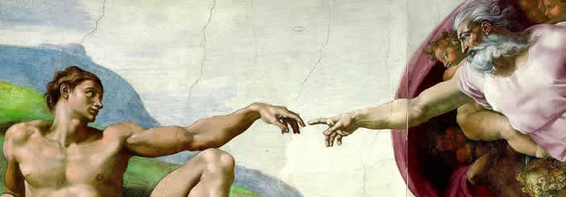
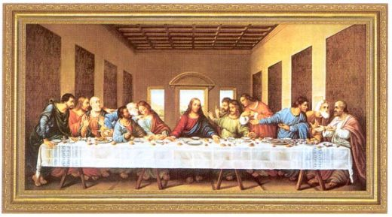
Renaissance Vocabulary

Slide 2
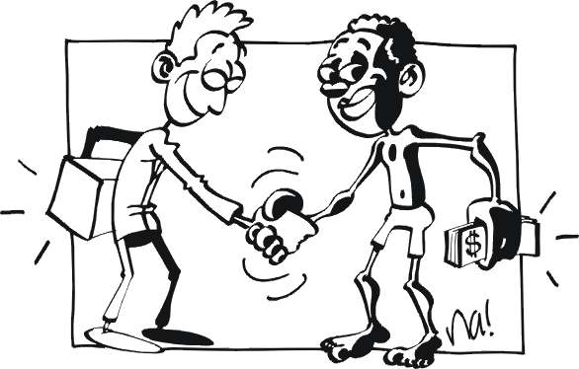
Commerce
The buying and selling of a large quantity of goods.
The buying and selling of things.

Slide 3
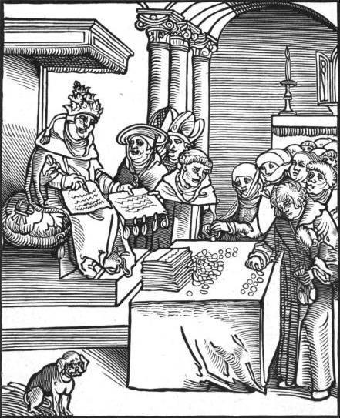
Indulgence
In the Roman Catholic Church, a pardon for sins
Paying the church for your sins

Slide 4
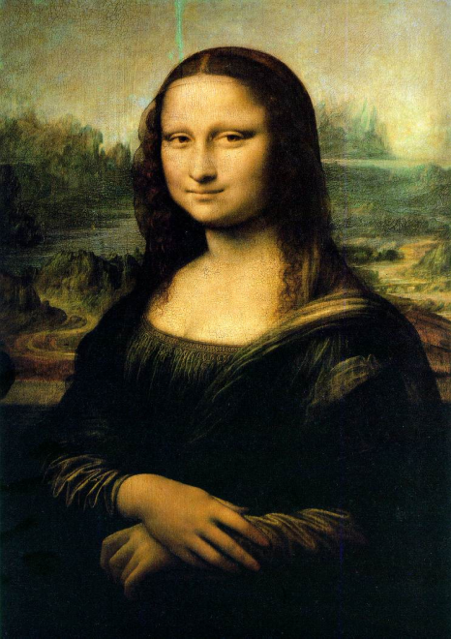
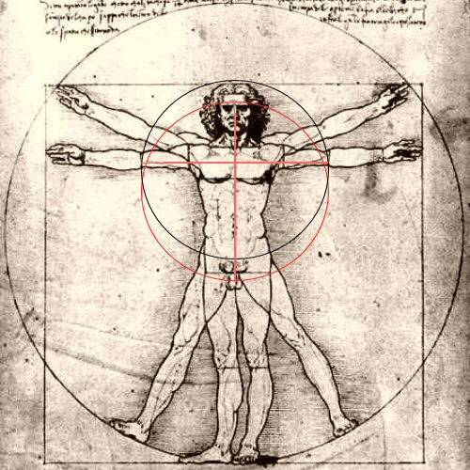
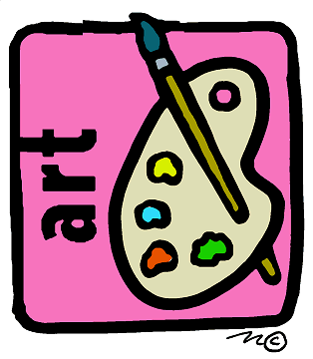
Renaissance
The intellectual and economic movement that began in the mid 1400’s and lasted till the 1600’s. It saw a revived interest in art, social, scientific, and political thoughts of Greece and Rome.
A movement after the Middle Ages that began because of a revived learning of Greek and Roman thinking and art.
+

Slide 5
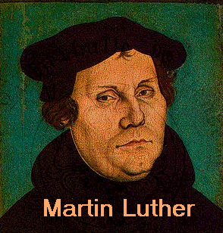
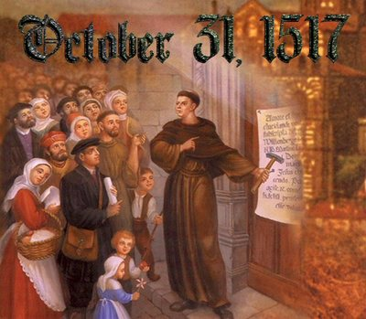
Protestantism
The religion of Protestants, or Christians who led a movement against the beliefs and practices of the Roman Catholic church.
A branch of Christianity, that developed because of different beliefs and practices.

Slide 6
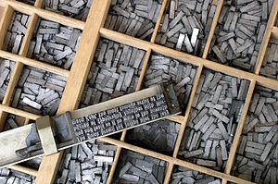
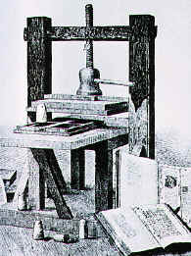
Movable Type (Printing Press)
Small, reusable metal blocks used to print letters and numbers.
A machine used to copy books and documents.

Slide 7
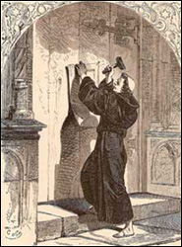
Reformation
The religious movement in Europe that aimed at reforming the Roman Catholic Church but led to the establishment of Protestantism.
A religious movement which set out to change some of the churches practices.

Slide 8
Counter-Reformation
Response and reforms by the Roman Catholic Church to the Protestant Reformation
Changes in the church practices because of the Protestant movement.
X

