Slide 1
World Religions

Slide 2
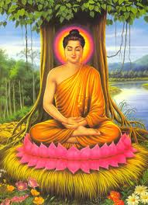
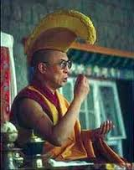
Buddhism
Buddhism is a religion that was started by Siddhartha Gautama.
The holy book of Buddhism is called the Ripitaka.
Teachers of the Buddhist faith are monks called a Bodhisattva.

Slide 3
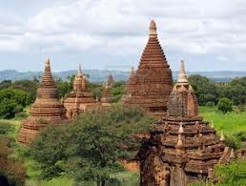
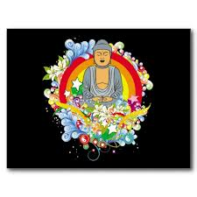
Buddhism
The place where Buddhists practice their religion is called a Buddhist Temple
Buddhists believe that people should stop wanting worldly things, so they can reach a state of wisdom called Nirvana.

Slide 4
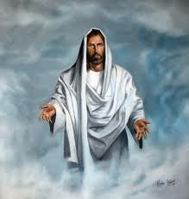
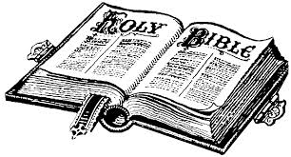
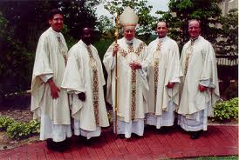
Christianity
Christianity is a monotheistic religion based on the teachings of Jesus of Nazareth.
The holy book for the Christians is the Bible.
Teachers of the Christian faith are called priests.

Slide 5
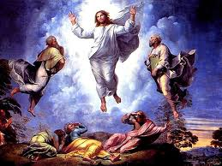
Christianity
Christians practice their religion in places called churches.
Christianity is based on the death and resurrection of Jesus, which allows mankind to enter Heaven.

Slide 6
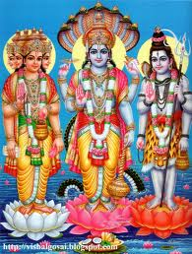
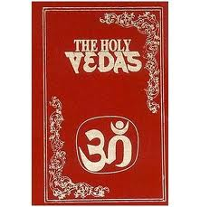
Hinduism
Hinduism is a polytheistic religion created by the people of India.
The main Gods of Hinduism are Brahma, Shiva, and Vishnu.
The holy book of Hinduism is called the Vedas.

Slide 7
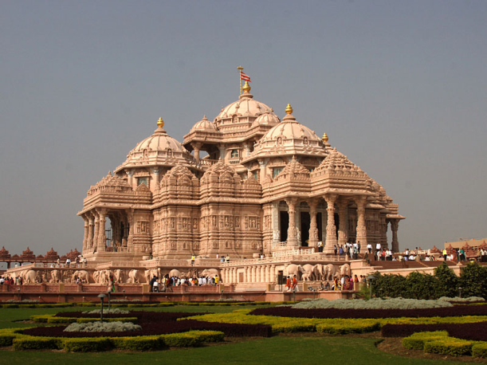
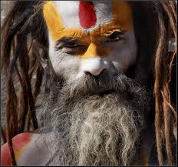
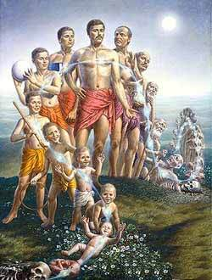
Hinduism
Hinduism is practiced in a place called a Hindu Temple.
Teachers of the Hindu faith are called Gurus.
Hindus believe in reincarnation, or the idea of living many different lives.

Slide 8
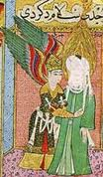
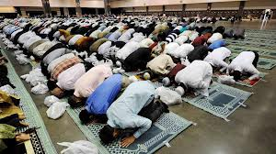
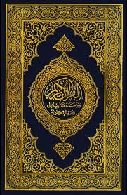
Islam
Islam is a monotheistic religion started by Muhammad, after being visited by the Angel Gabriel.
Followers of Islam are called Muslims.
The holy book of Islam is called the Quran (Koran).

Slide 9
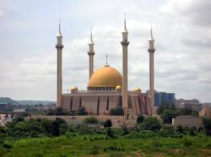
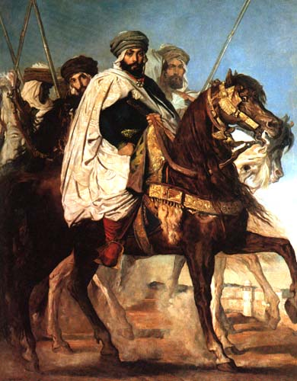
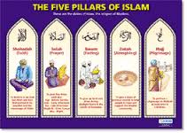
Islam
Muslims worship at a place called a Mosque.
The leaders of the Muslim faith are called Caliphs.
Muslims are expected to follow the 5 Pillars of Islam, which include Belief, Prayer, Charity, Fasting, and Pilgrimage.

Slide 10
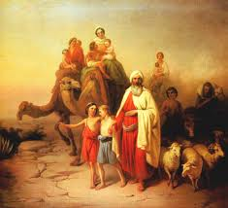
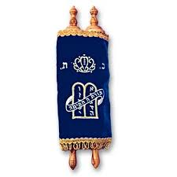
Judaism
Judaism is a monotheistic religion that was started by Abraham, after being spoken to by his God.
The people who practice Judaism are called Hebrews or Jews.
The holy book of Judaism is called the Torah.

Slide 11
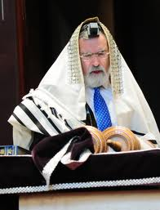
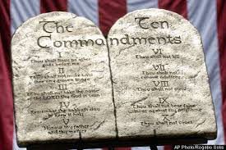
Judaism
Hebrews practice their religion in a place called a Synagogue.
Teachers of the Jewish faith are called Rabbis.
Moses was given the 10 Commandments by God, according to the Torah.

